Slide 1
The Wire-Bird
By Suveer and Avyukt

Slide 2
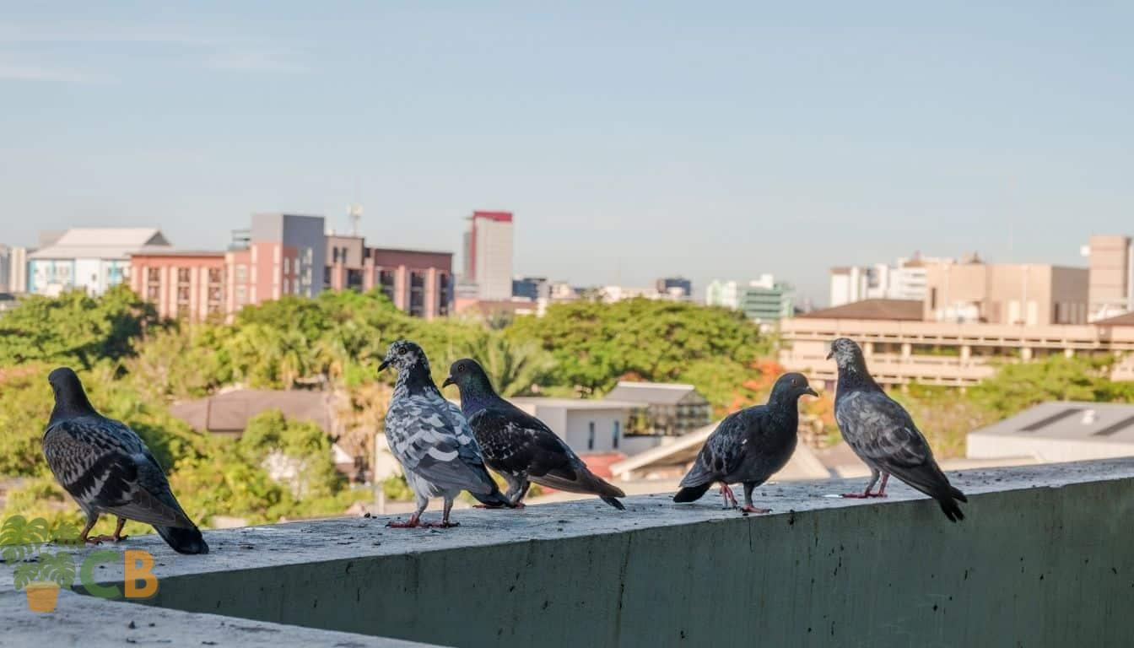
Problem Statement
The problem that we are trying to solve is pigeons dirtying the balconies in apartment buildings, creating unwanted noise and annoying pets like dogs causing even more noise.
Another problem is related to pigeon droppings. Humans can get infected with diseases like Psittacosis if the dust created while cleaning droppings is inhaled.

Slide 3
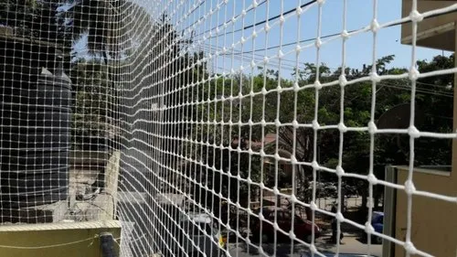
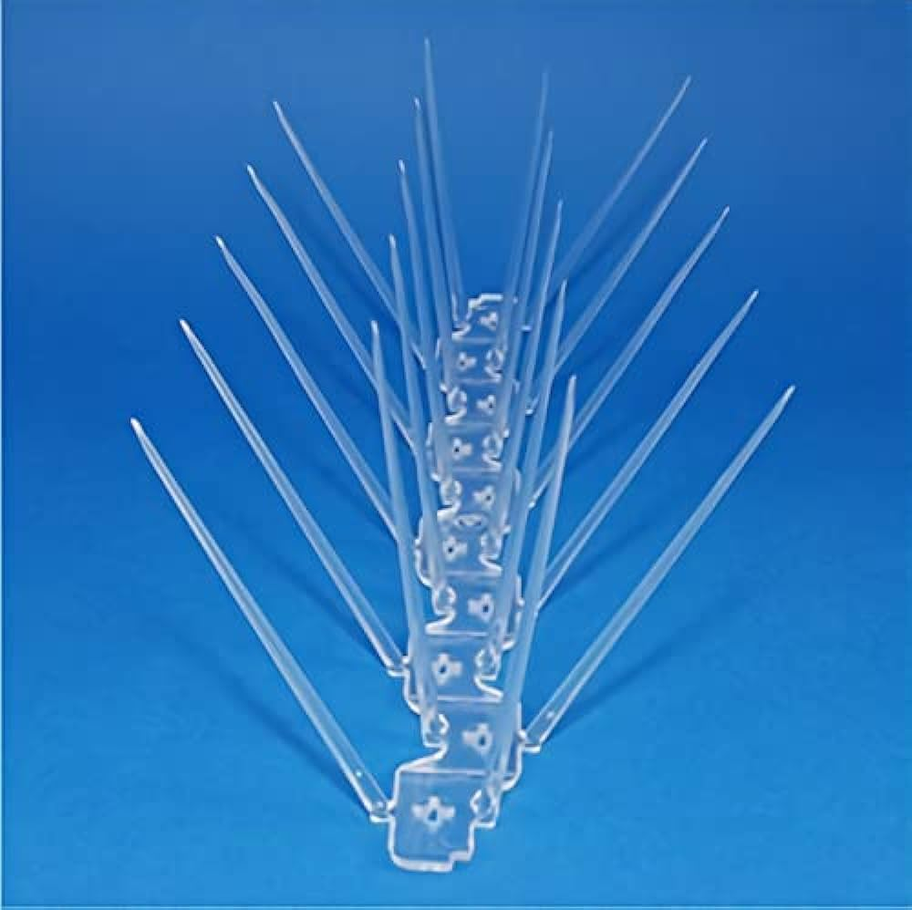
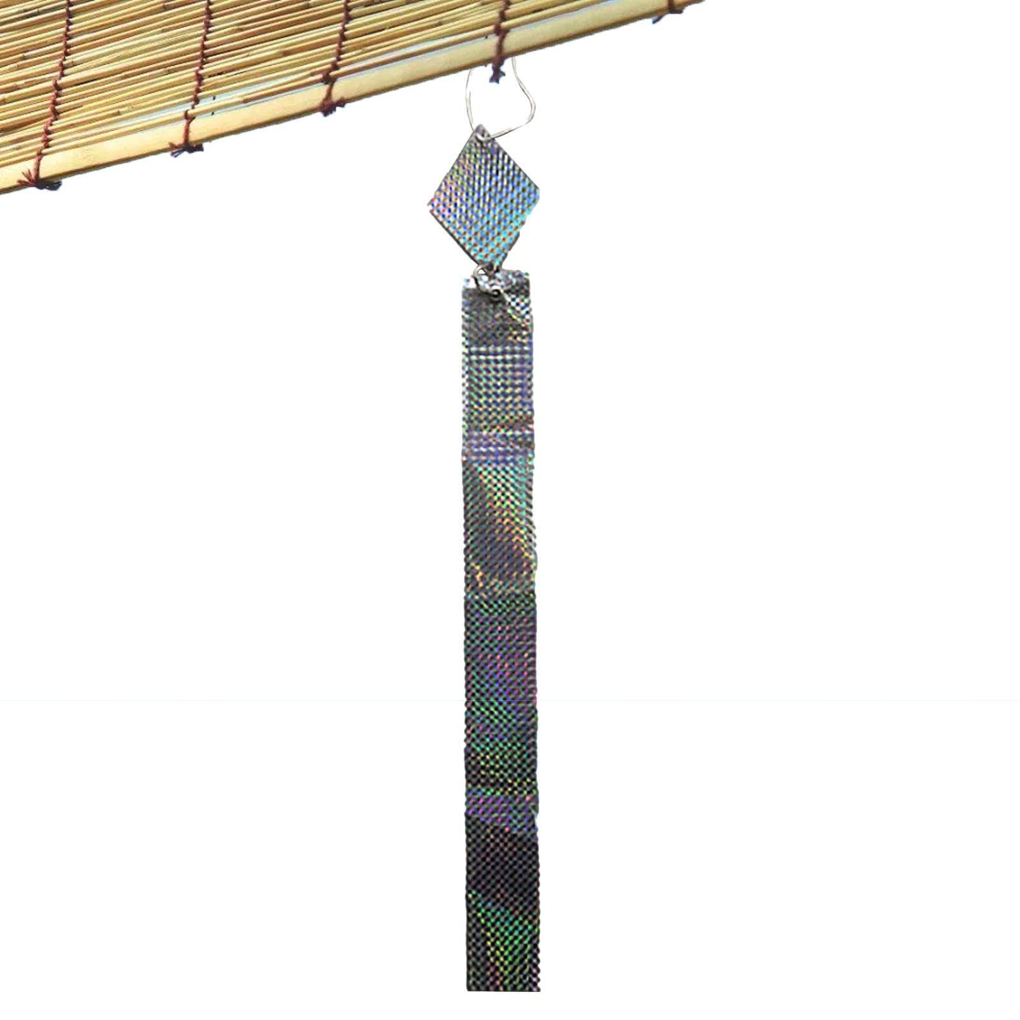
Other solutions
There are many products that have been created to combat this problem. These products are installed in homes to prevent pigeons.

Slide 4
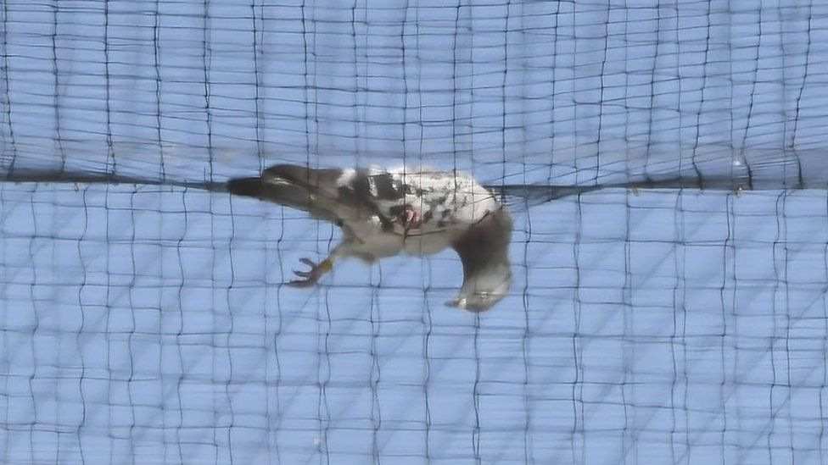
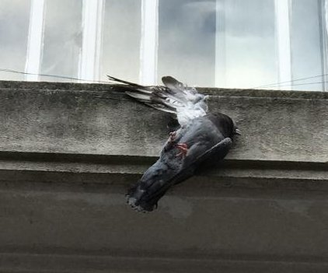
What are the cons?
The cons of products such as the spikes and nets are that they tend to cause injuries to the pigeons. These injuries could also lead to the death of the pigeons

Slide 5
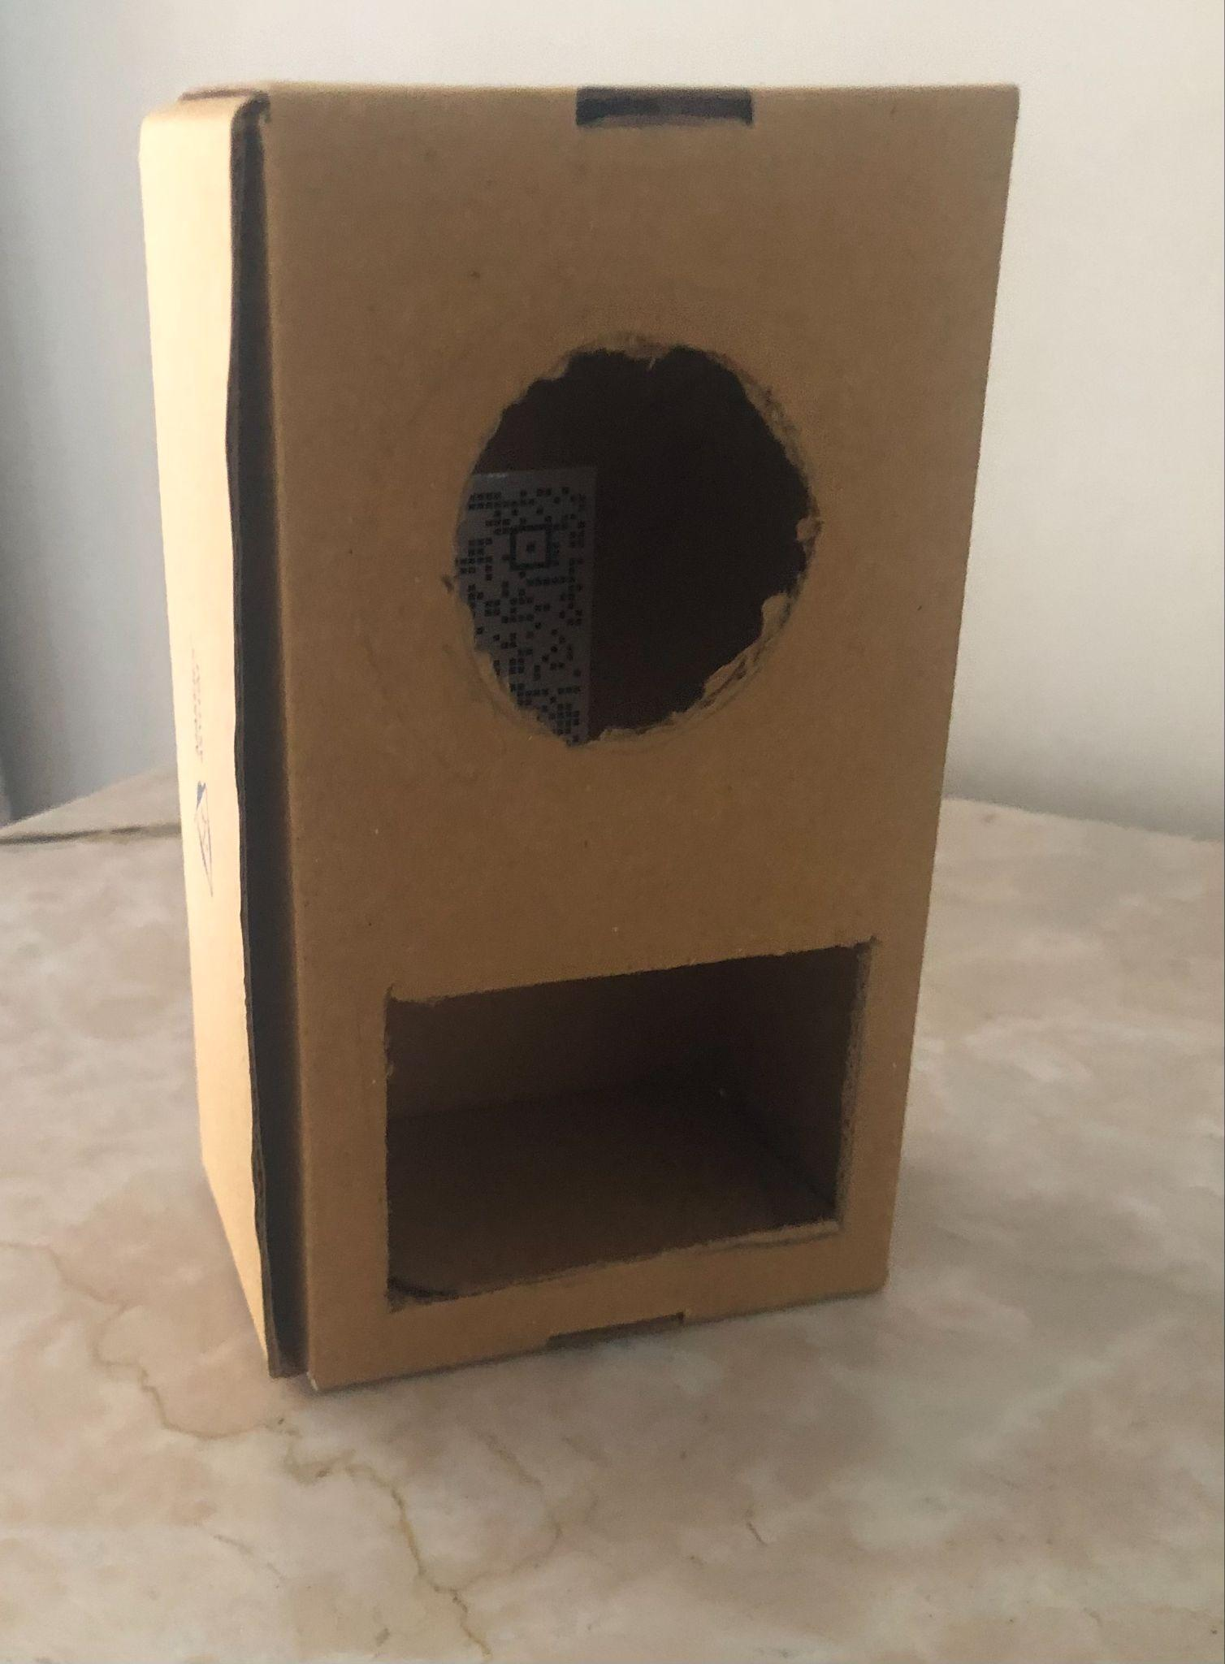
Our journey
At first, we decided to take forward a previous Maker’s Asylum project which involved buzzers with high frequencies.
Paper Prototype for the buzzer based system
Then, we thought of changing it. The reason behind the change is that the high frequency noise of the buzzer was very irritating, especially to dogs as they have very sensitive hearing.

Slide 6
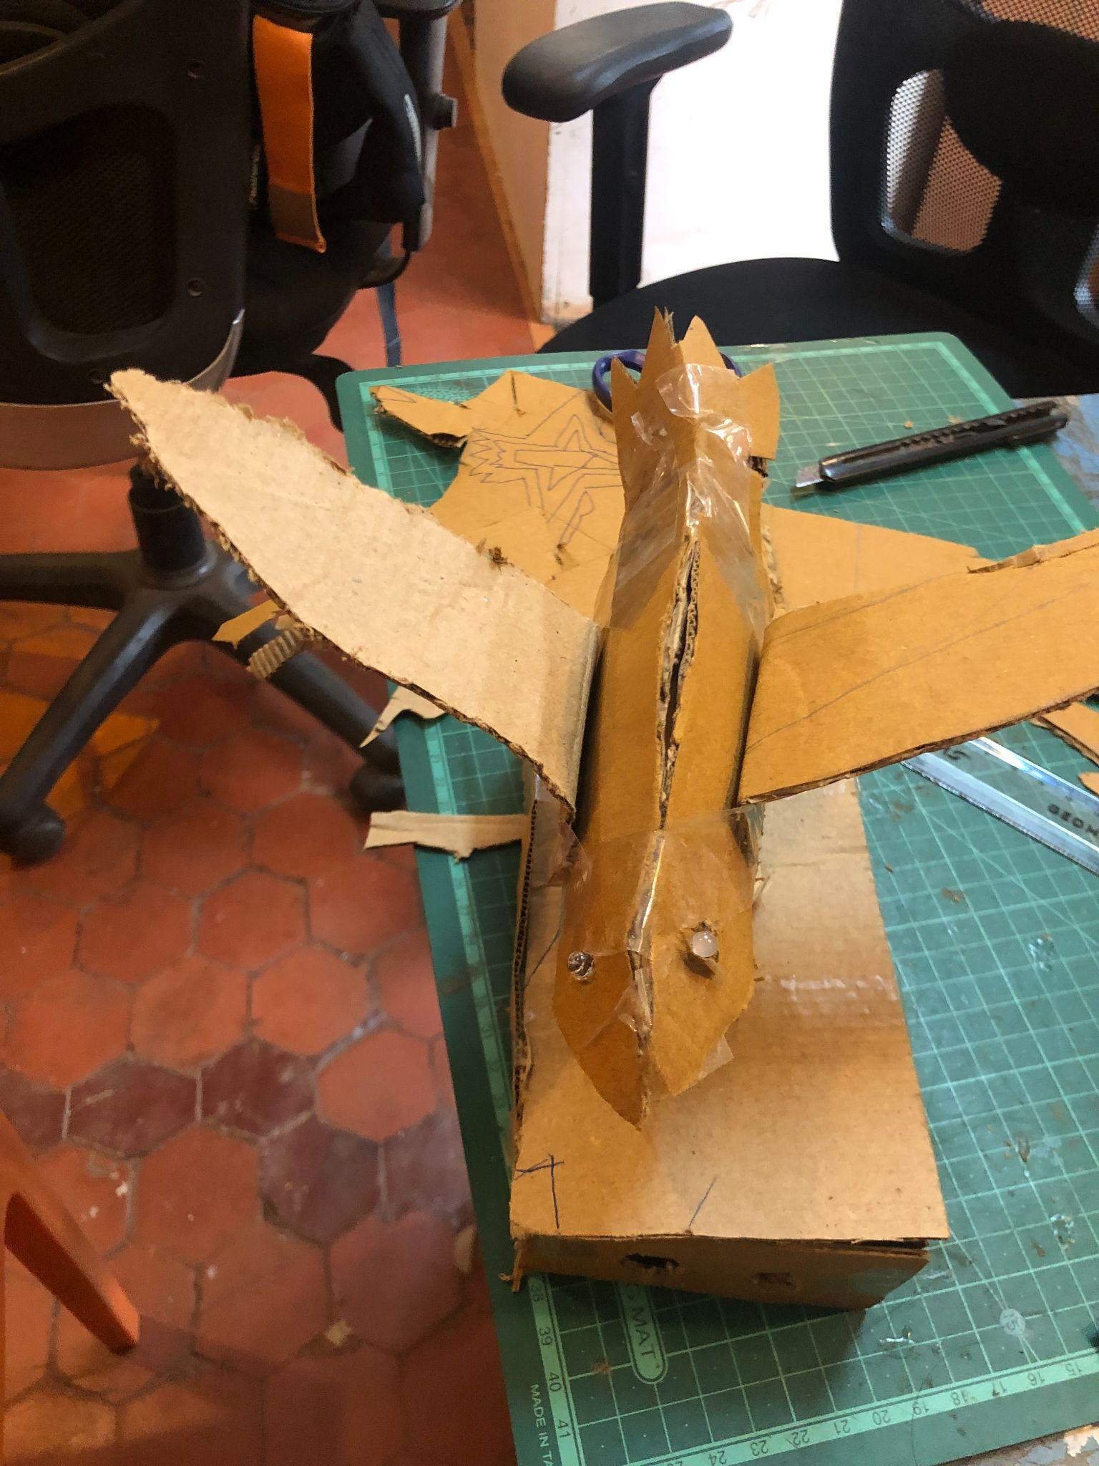
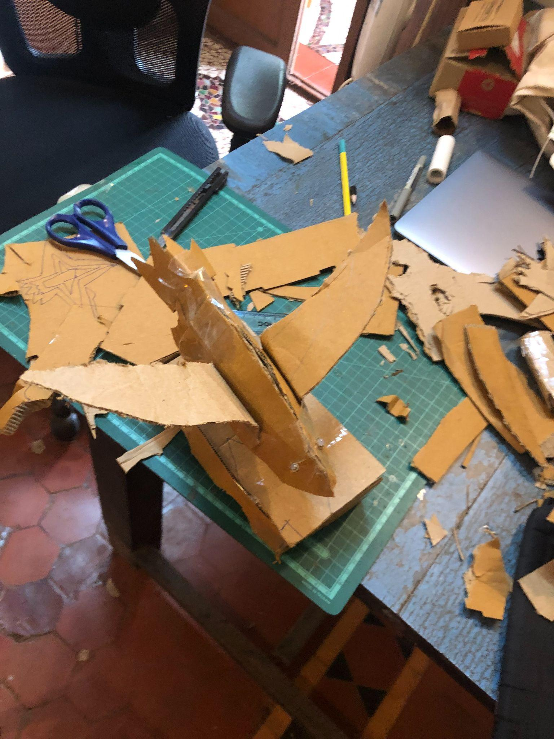
Few of our prototypes

Slide 7
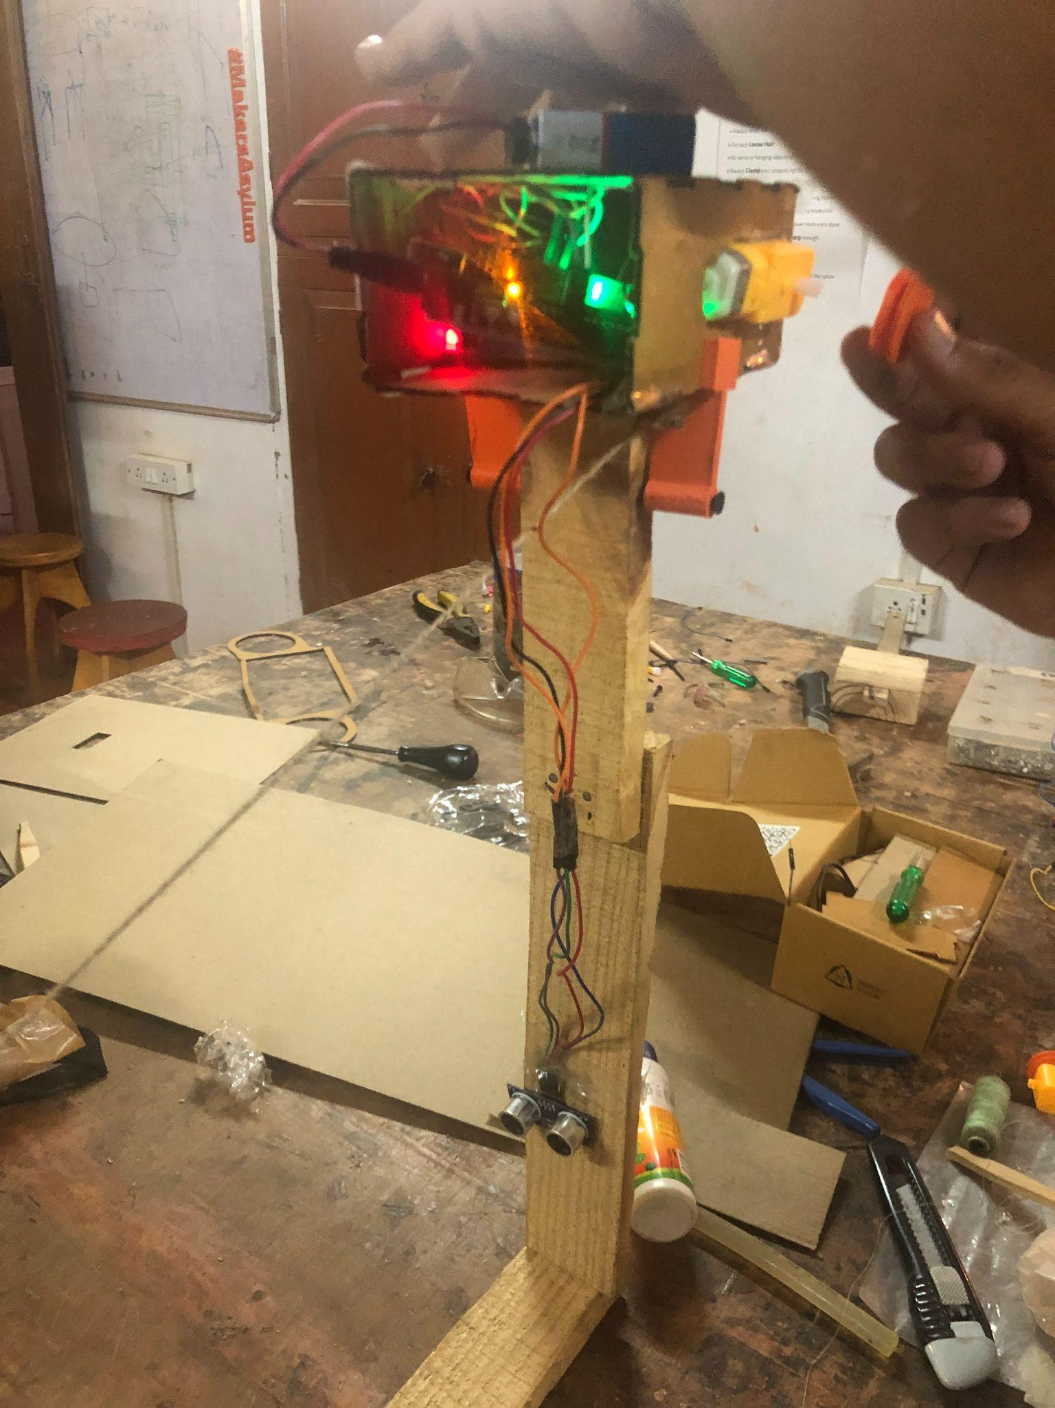
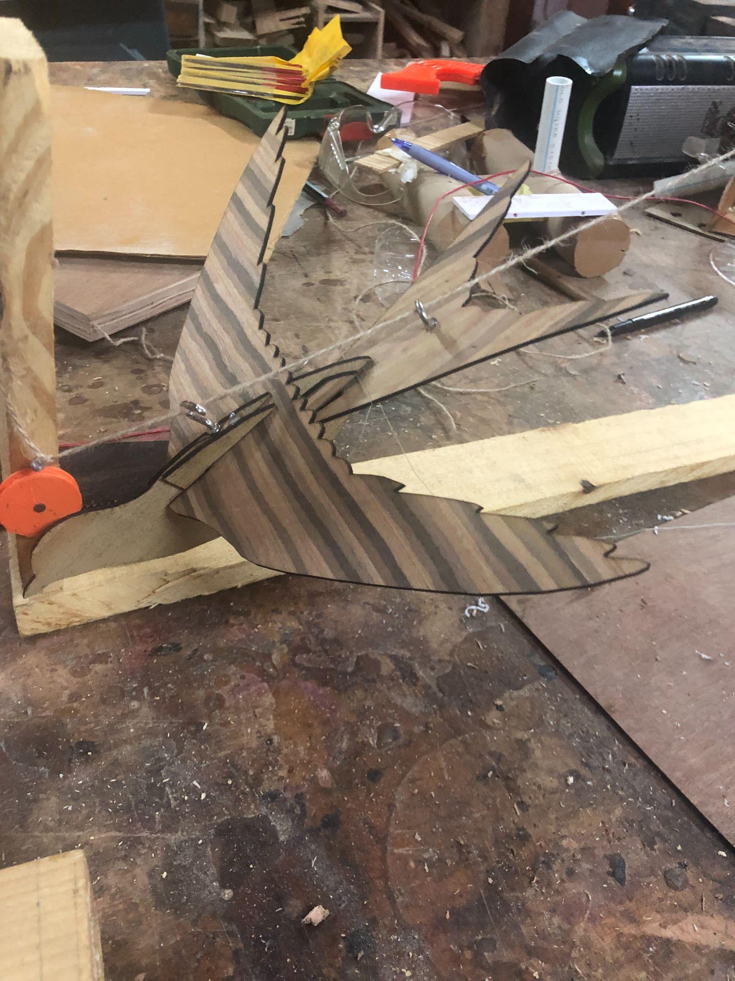
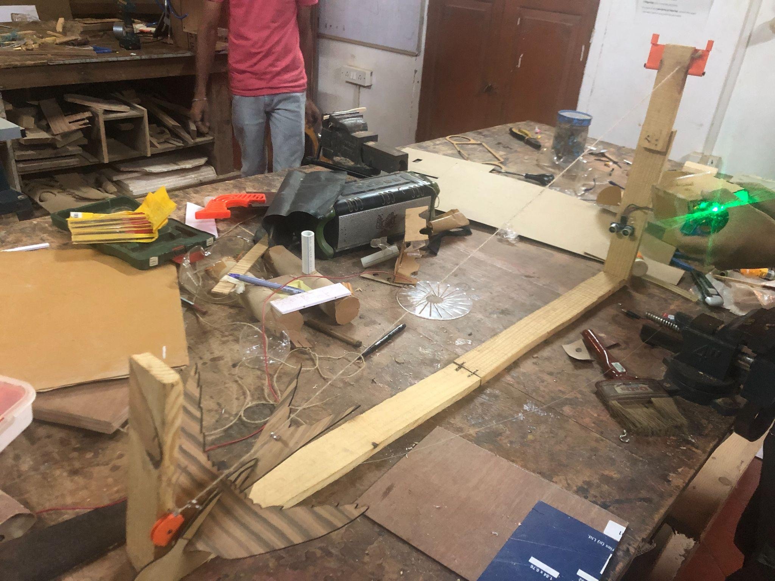
Our solution
So this is what we finally came up with!!
The project we have created involves a ziplining model bird which will scare away the pigeon(s).
The idea behind this contraption is to deter pigeons away from balconies without physically hurting them.

Slide 8
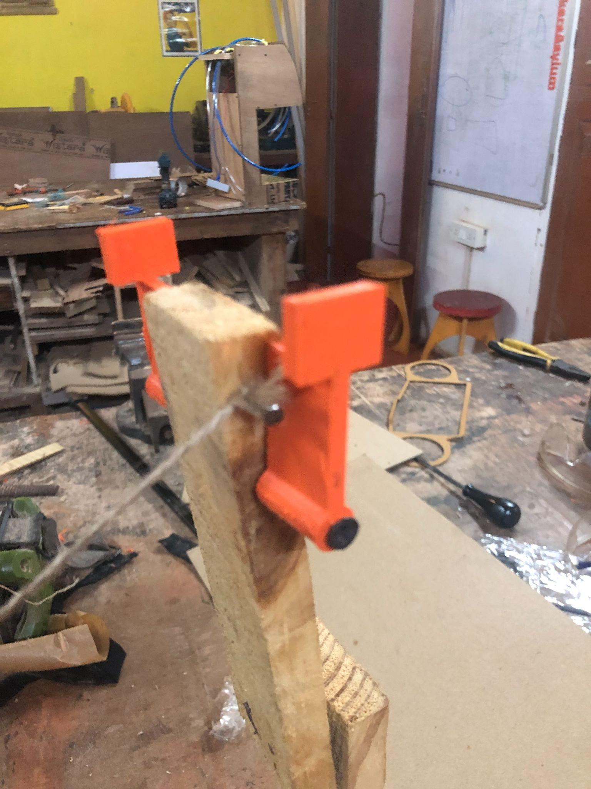
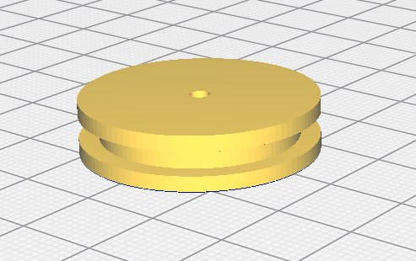
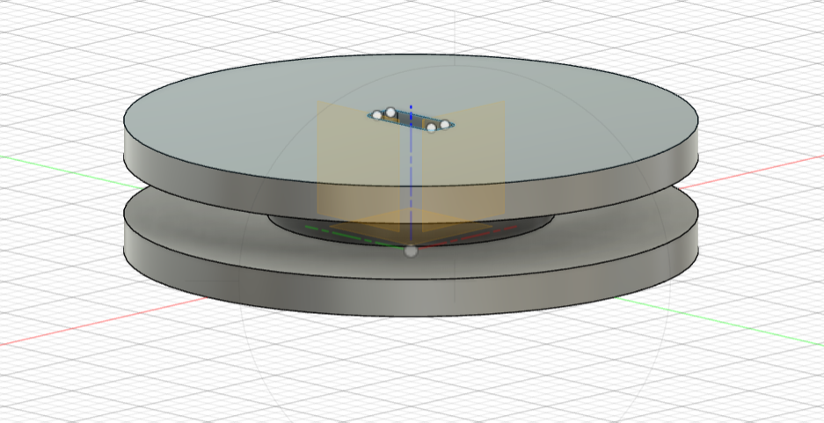
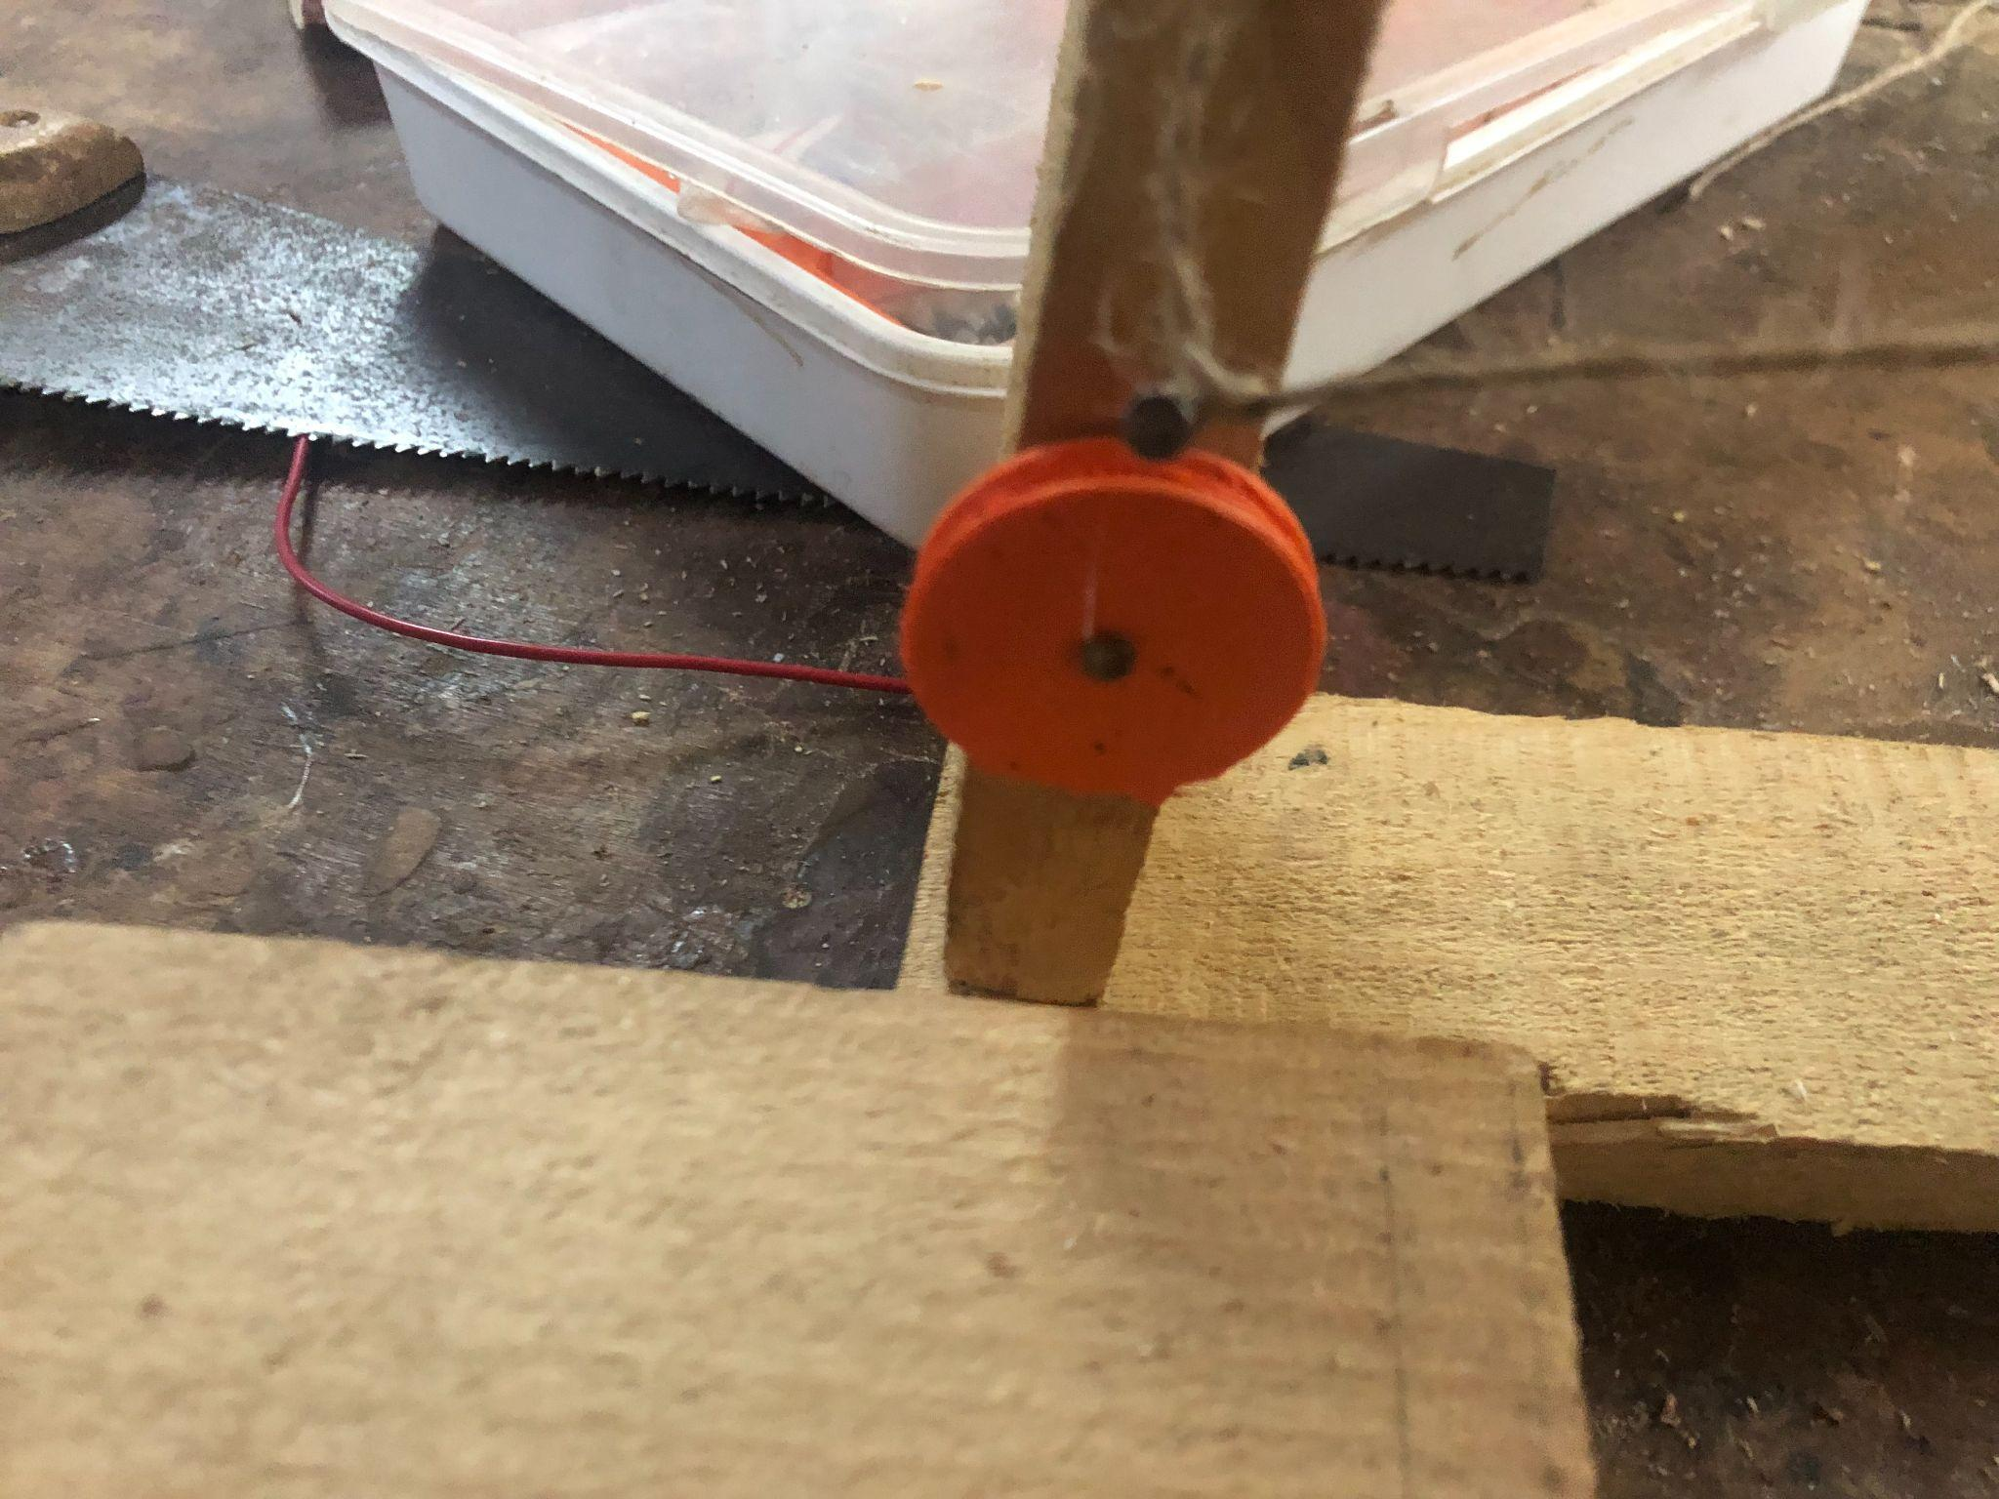
CAD Models

Slide 9
Our list of materials
DC Motor
Ultrasonic Sensor
Relay
Arduino Uno
Jumper wires
3D printed cardboard parts
Thread
Rope
9V Batteries
Wood

